Slide 1

INSURANCE CLAIM FRAUD PREDICTION WEB APP USING ML & FLASK WEB FRAMEWORK
TEAM MEMBERS:
GUIDE:
- 811720243029 - MOHAMED THANISH.M
- 811720243302 - BALAJI.S
- 811720243036 - SAM ARAVIND.R
MS.S.MURUGAVALLI.,B.Tech.,M.E.,
ASST HOD OF AI DEPT
8/12/2022
1

Slide 2
ABSTRACT
Fraudulent insurance claims is the problem faced by many of the insurance companies which leads to huge financial loss Insurance fraud is a challenging problem for the insurance industry.so we chose to do a project based on the insurance claims fraud prediction using machine learning.
These project are going to identify potential fraud insurance claims and help insurance company to make more secured claim authentication & settlement by early identifications of probable fraud claims. Solution of these problem is to Build a classification methodology AI based App to determine whether a customer is placing a fraudulent insurance claim using ML algorithms such as random forest , XGBoost classifier, logistic regression, ensemble methods ,SVM ,KNN & also using HTML,FLASK for front end development.
The aim is to identify fraud claims accurately within shorter period of time. Throughout the process data analysis is used to validate, clean and extract the relevant data.

Slide 3
LITERATURE SURVEY
TITLE | AUTHOR | PUBLICATION | ALGORITHM USED | ADVANTAGES | DISADVANTAGES
DETECTING INSURANCE CLAIMS FRAUD USING MACHINE LEARNING TECHNIQUES | Riya Roy, Thomas George K | IEEE | Decision tree(DT), Random forest(RF), Naïve Bayes(NB). | It increased the generalization ability of the models decreased the uncertainty of prediction. | compare with the algorithms, decision tree and random forest algorithms have better performance than naïve bayes.
ROBUST FUZZY RULE BASED TECHNIQUE TO DETECT FRAUDS IN VEHICLE INSURANCE | K. Supraja , S.J. Saritha | IEEE | Bayesian algorithm, Fuzzy Logic, S-curve | Accurate And Early Predictions | Bayesian algorithm gives the less accuracy and complexity is very high

Slide 4
INSURANCE FRAUD DETECTION USING MACHINE LEARNING | Soham Shah, Shrutee Phadke, Princia Koli, Shweta Sharma | IRJET | XGBoost Algorithm,decision tree | versatile, robust | Decision tree algo only gives 70% of accuracy and it takes time.
ENHANCING CLAIMS HANDLING PROCESSES WITH INSURANCE BASED LANGUAGE MODELS | suraj,delip | IEEE | IBLMs , BERT | smallest error rate in the prediction | It needs high storage space and costly.
DETECTING FRAUDULENT MOTOR INSURANCE CLAIMS USING SUPPORT VECTOR MACHINES WITH ADAPTIVE SYNTHETIC SAMPLING METHOD | ahmed ali | IEEE | SVM and ADASYN | can be easily constructed. | Different machine learning algo and feature selection methods performed differently for various stocks, which would not be the case if the fraud had followed a random pattern

Slide 5
AUTOMOBILE INSURANCE FRAUD DETECTION USING SUPERVISED CLASSIFIERS | arinin deni ,enrico loah | IEEE | MLP, random forest , SMOTE | Gives 83% of accuracy compared to others | It higher time to train the model.
ANALYSIS ACCURACY OF XGBOOST MODEL FOR MULTICLASS CLASSIFICATION - A CASE STUDY OF APPLICANT LEVEL RISK PREDICTION FOR LIFE INSURANCE | YEkti Widyaningsih,hendri | IEEE | XGBoost,bayesian | provide high performance accuracy and easy to understand | Hardware dependence, Unexplained behavior of the network, prediction accuracy of 78%
ADATA MINING BASED TARGET REGRESSION-ORIENTED APPROACH TO MODELLING OF HEALTH INSURANCE CLAIMS | Harshvardhan GM | IEEE | Random Forest Regression | Algorithm eliminates overfitting as the result is based on a majority vote or average. | parameters have been chosen for high time data consumption

Slide 6
SYSTEM SPECIFICATION
H/W SYSTEM CONFIGURATION: -
S/W SYSTEM CONFIGURATION: -
Processor – Intel Corei5,GPU
RAM - 4 GB (Min) Or Higher
Hard Disk - 20 GB
Keyboard – Standard Keyboard
Monitor – 20 Inch Color Monitor
Operating System : Windows 8 and above
Front End : PYTHON
Back End : MySQL
APP : web app
PLATFORM : VS CODE
8/12/2022
6

Slide 7
SYSTEM ANALYSIS
EXISTING SYSTEM
An insurance claim fraud prediction is a challenging task since the factors Involved in pricing dynamically change overtime. In the last decade, researcher have incorporated ML algorithms & Data mining strategies to better model observed prices but accurate results are not predicted since there is no day to day price comparison.
ALGORITHMS USED:
Logistic Regression, Naive Bayes Algorithm, Softmax Regression Algorithm, Support Vector Machine, Linear Regression Algorithm

Slide 8
LOGISTIC REGRESSION :
Logistic regression is used to predict the probability of a target variable. The nature of target or dependent variable is dichotomous, which means there would be only two possible classes. Mathematically, a logistic regression model predicts P(Y=1) as a function of X.
SUPPORT VECTOR MACHINE:
The goal of the SVM algorithm is to create the best line that can segregate n-dimensional space into classes so that we can easily put the new data point in the correct category in the future. This best decision boundary is called a hyperplane. SVM chooses the extreme points/vectors that help in creating the hyperplane.

Slide 9
PROPOSED SYSTEM:
In here we use Random Forest Algorithm & XGBoost algorithm.
RANDOM FOREST ALGORITHM:
The greater the number of trees in a Random Forest Algorithm, the higher its accuracy and problem-solving ability. Random Forest is a classifier that contains several decision trees on various subsets of the given dataset.
XGBOOST ALGORITHM:
The XGBoost is a popular and efficient open-source implementation of the gradient boosted trees algorithm. Gradient boosting is a SL algorithm that attempts to accurately predict a target variable by combining an ensemble of estimates from a set of simpler and weaker models.

Slide 10
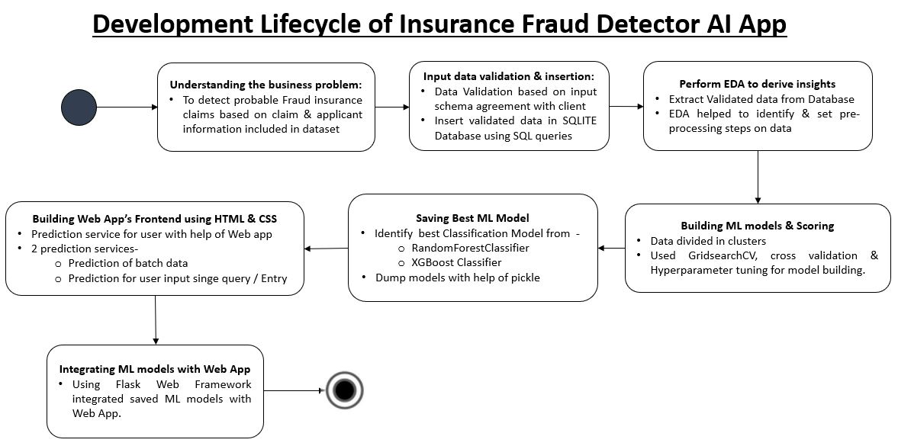
ARCHITECTURAL DESIGN

Slide 11
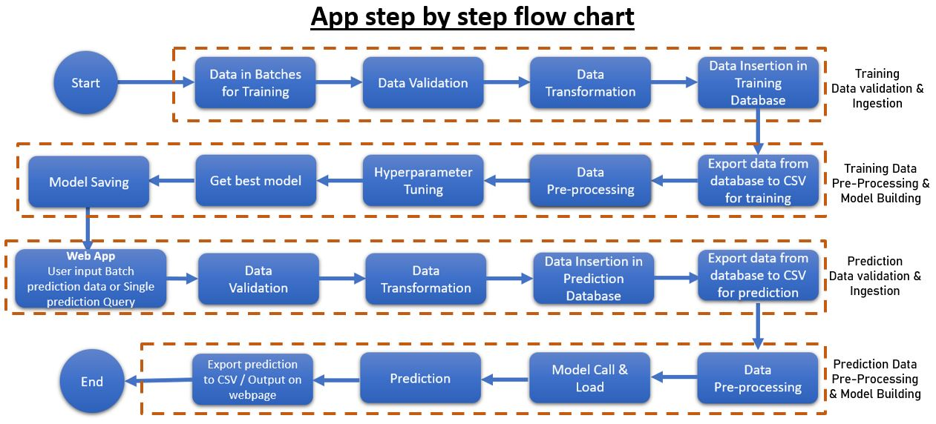

Slide 12
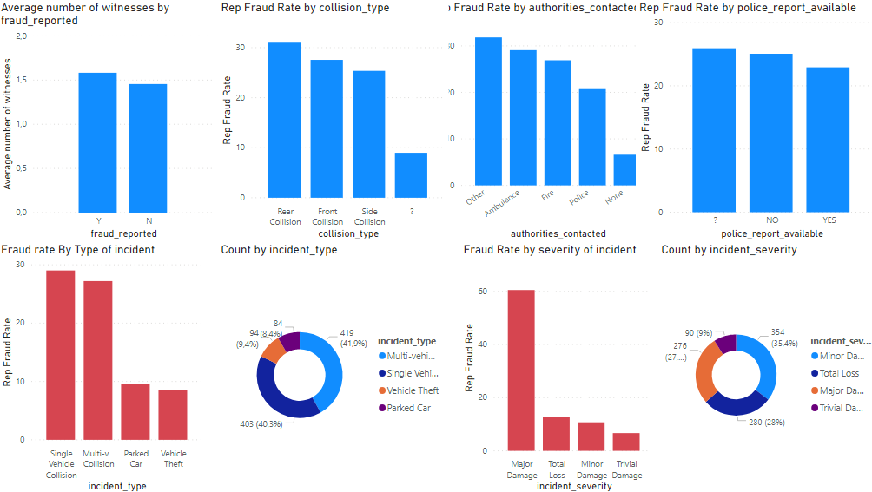
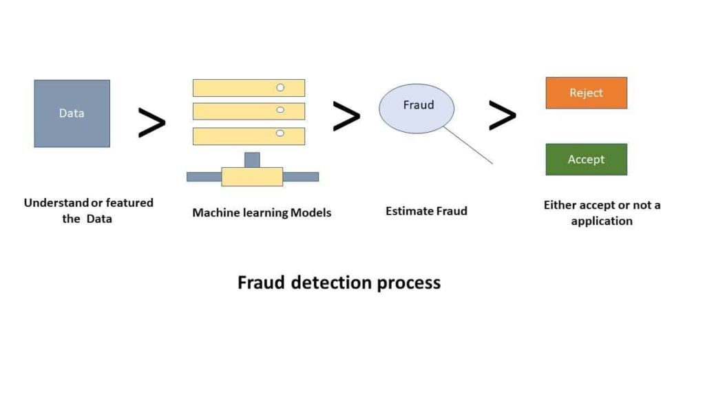

Slide 13
MoDULE DESCRIPTION
DATA COLLECTION:
In this process to collect a data from github and Kaggle. This data collection has an only numerical value and, in this data, using multiple purpose. Github & Kaggle supports a variety of dataset publication formats, but we strongly encourage dataset publishers to share their data in an accessible, non- proprietary format if possible.
DATA PREPROCESSING
Data pre-processing is a process of preparing the raw data and making it suitable for a deep learning model. It is the first and crucial step while creating a deep learning model.

Slide 14
CREATION OF TREES USING C4.5 ALGORITHM
The trees that are built in our system are done so using C4.5 algorithm that is available on the internet. This algorithm uses gini index in order to find efficient split conditions for formation of daughter trees.
MODEL SELECTION
Model selection is the process of selecting one final machine learning model from among a collection of candidate machine learning models for a training dataset.
PERFORMANCE EVALUVATION
In this process is used to implement the project Accuracy.

Slide 15
XGBoost ALGORITHM:
XGBoost is an optimized distributed gradient boosting library designed to be highly efficient, flexible and portable. It implements Machine Learning algorithms under the Gradient Boosting framework. It provides a parallel tree boosting to solve many data science problems in a fast and accurate way.
The XGBoost algorithm performs well in machine learning competitions because of its robust handling of a variety of data types, relationships, distributions, and the variety of hyper parameters
compute the average of target variable as prediction and calculate the residuals using the desired loss function.

Slide 16
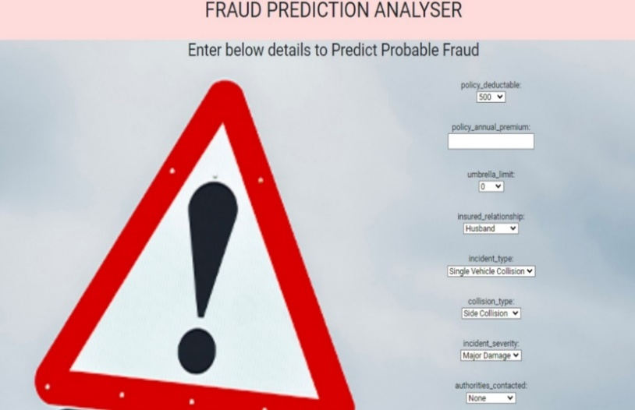

PROJECT MODEL & DEPLOYMENT
WEB APP MODEL

Slide 17
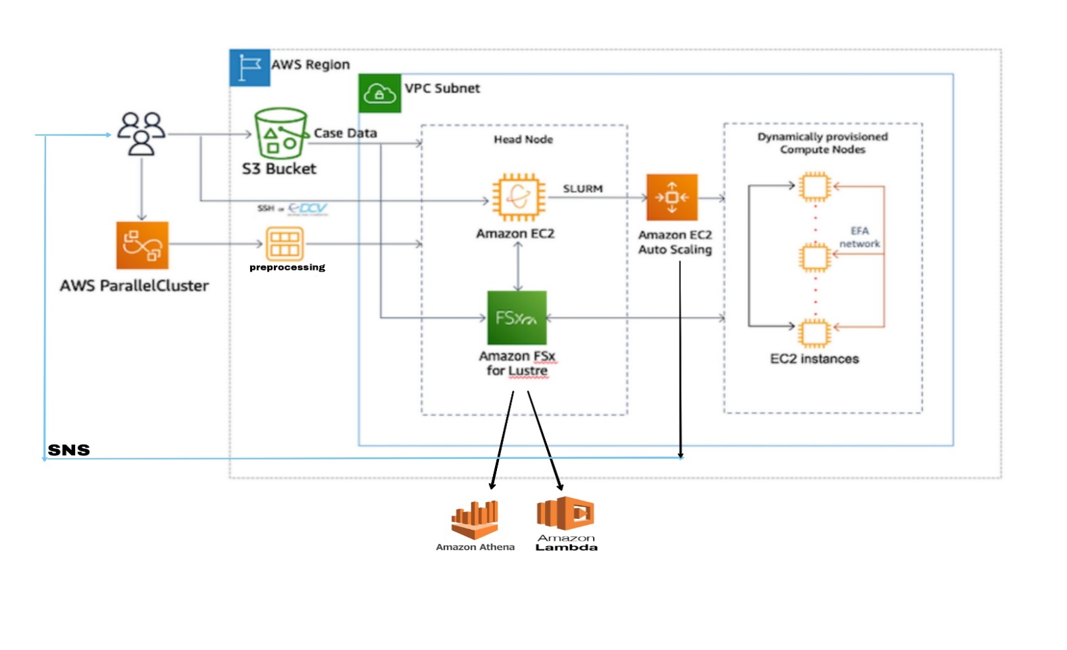
DEPLOYMENT & AWS ARCH :
Amazon Web Services (AWS) delivers reliable, scalable, and cost-effective computing resources on which to host our web applications.

Slide 18
AWS SERVICES USED :
AWS PARALLELCLUSTER
It is an open source cluster management tool that makes it easy for you to deploy and manage High Performance Computing (HPC) clusters on AWS.
AMAZON S3
Amazon S3 to store and protect any amount of data for a range of use cases, such as data lakes, websites, mobile applications, backup and restore, archive, enterprise applications, IoT devices, and big data analytics.
AMAZON EC2
Amazon EC2 provides scalable computing capacity in the AWS Cloud. Using Amazon EC2 we can develop and deploy applications faster.

Slide 19
AMAZON EC2 AUTOSCALING
It helps you maintain application availability and allows you to automatically add or remove EC2 instances according to conditions you define.
AMAZON VPC
Amazon VPC enables you to launch AWS resources into Amazon Virtual Private Cloud a virtual network and closely resembles a traditional network that you'd operate in your own data center, with the benefits of using the scalable infrastructure of AWS
AMAZON FSx
Amazon FSx makes it easy and cost effective to launch, run, and scale feature-rich, high-performance file systems in the cloud. In AMAZON FSx we use AWS LAMBDA & AWS ATHENA.

Slide 20
CONCLUSION
After using this approach we can easily detect the potential frauds in the claims and also probability of fraud. By using this approach, we can early detect the frauds and this will be helpful in:
Reduction in fraud investigation expenses.
Lowers claim handling cost
Efficiently manages claims severity
Detection of early claims in the life cycle is paramount to managing overall claims costs.

Slide 21
FUTURE SCOPE
AI technology not only automates the fraud detection process but also identifies fraud patterns allowing early flagging and prompt response to any potential incidents.
As the number of clients increases, claims adjusters are put under higher pressure and should either sacrifice the accuracy or the speed of the claims process. On the contrary, the more data machine learning algorithms receive, the faster they provide accurate results.
Next, predictive analytics delivers way more accurate results than a human agent can do. As a result of processing big data, digital tools have more information to make decisions with never before seen accuracy.

Slide 22


